Slide 1
Electronic Portfolios and Stetson University
Implementation and its Correspondence to the Strategic Map

Slide 2
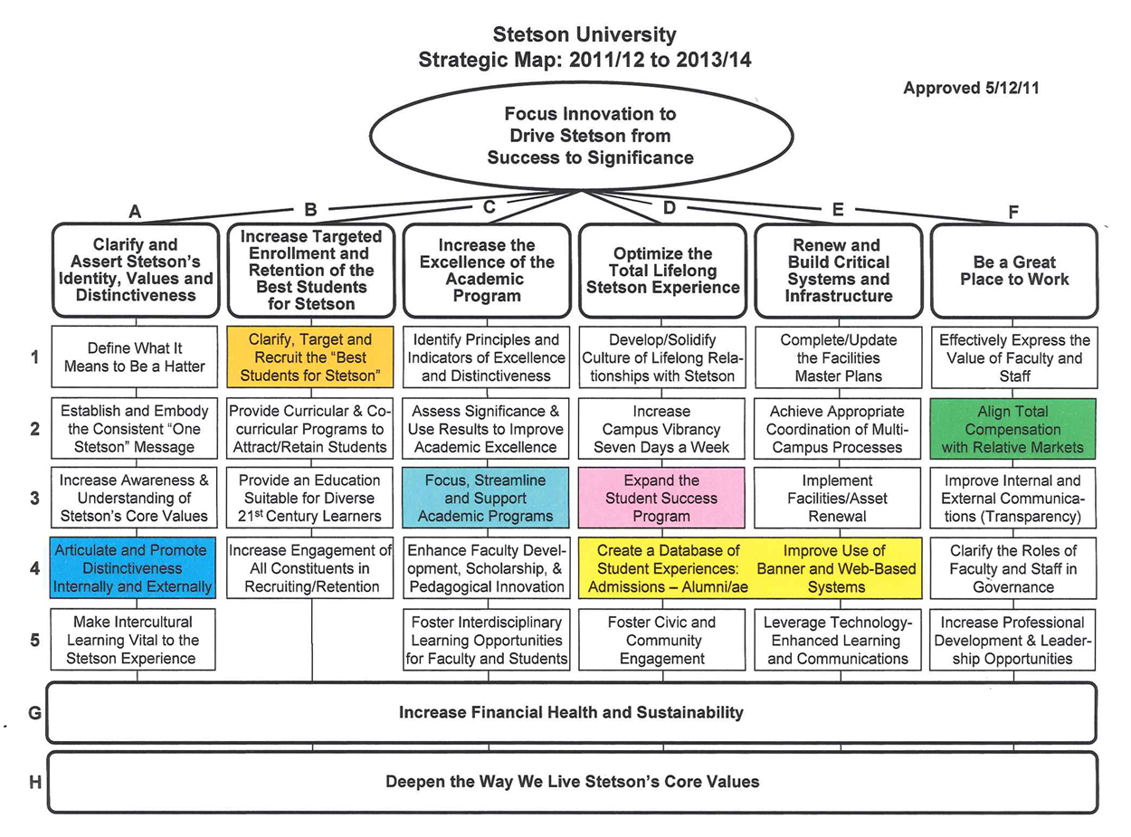
Stetson Strategic Map

Slide 3
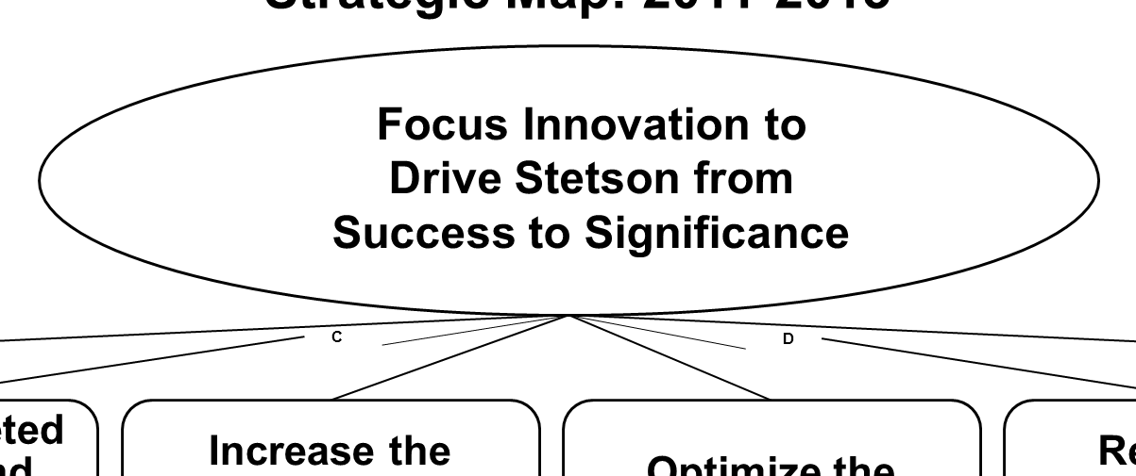
Focus Our Innovation (title)
“Have our mission drive our choice of innovation…
…Identify direction for action, take initial steps, be nimble.”
- Dr. Beth Paul
Small portfolio implementations can be quickly implemented by early adopters
Must be approved by faculty and senior administration to confirm direction

Slide 4
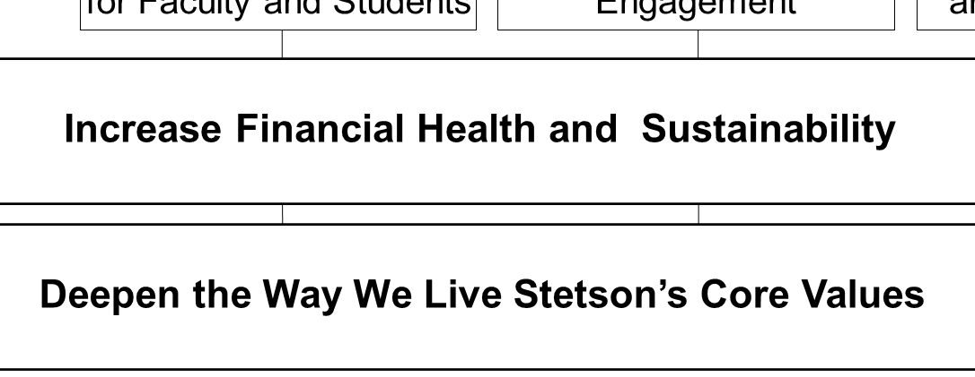
Cross-Cutting Strategic Priorities (H)
“Deepen the way we live our core values”
- Dr. Beth Paul
Reflection is a powerful capability of portfolios, and can be focused on core values, and be evidence thereof, especially in co-curricular activities

Slide 5
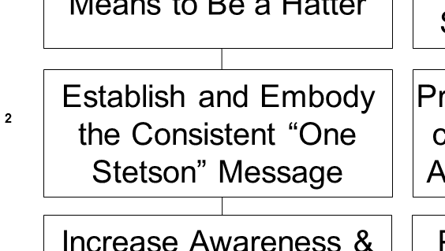
One Stetson (A-2)
“We should be consistent throughout the university with messaging.”
- Dr. Beth Paul
Portfolio implementation can account for all schools/colleges, achieve buy-in from Law, etc.

Slide 6
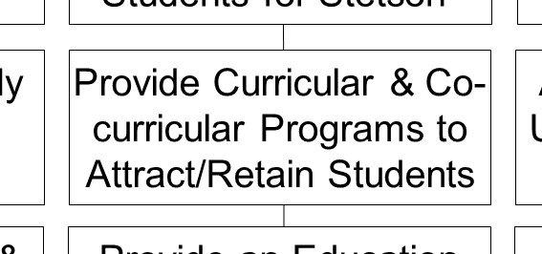
Attract and Retain Students (B-2)
“Help prospective students understand the kind of institution we are and retain them.”
- Dr. Beth Paul
Portfolios can be used to showcase what we do best

Slide 7
Attract and Retain Students (B-2)
“Offer inside and outside the classroom experiences.”
- Dr. Beth Paul
Keep students engaged, connected with each others re: specific area of learning
Promoting employment portfolio view is evidence of preparation for successful outcomes of a Stetson education
Portfolios provide evidence of progress to students, showing the evolution of their educations, supporting retention

Slide 8
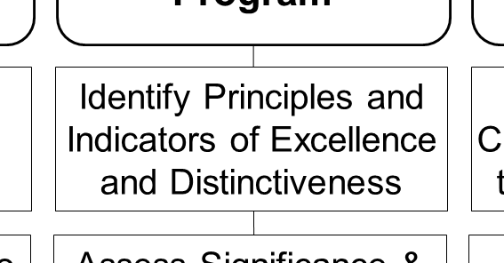
Identify Excellence and Distinctiveness (C-1)
“We’ve been doing lots of excellent things for a long time, can we identify them? We need to be able to do this to tell our story, and direct our choices.”
- Dr. Beth Paul
Portfolios can be excellent indicators of academic excellence
Portfolios can be used to help market Stetson

Slide 9
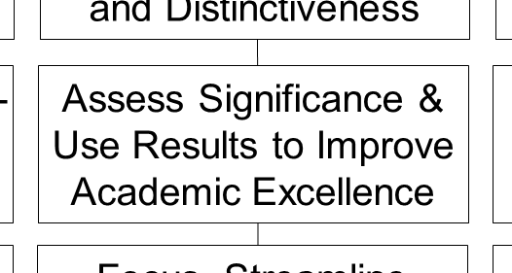
Assess Significance of Academics (C-2)
“Study how well our students are learning, use that information to help them learn even better.”
- Dr. Beth Paul
The scope of portfolios goes beyond the individual class, addresses accomplishments throughout the academic career, providing a more encompassing perspective than a course management system such as BlackBoard
Portfolios help provide evidence of institutional effectiveness for accreditation and guide decisions about implementation of resources

Slide 10
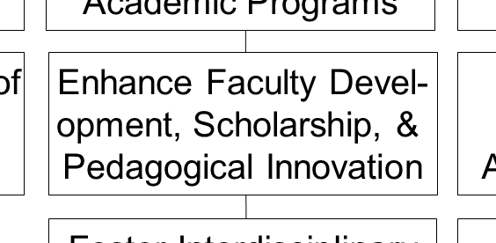
Enhance Faculty Development (C-4)
“Support faculty to be the best they can be, to continue to develop during their time with us.”
- Dr. Beth Paul
Portfolios provide a vehicle for showcasing faculty scholarship and accomplishments, encouraging dialog and conversation
Portfolios provide evidence of excellence in individuals, programs, and the entire university, and support marketing efforts

Slide 11
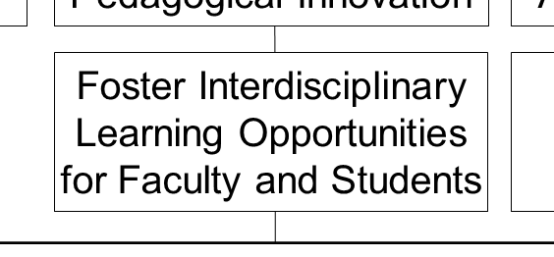
Foster Interdisciplinary Opportunities (C-5)
“We must provide 21st Century Learners with educators who foster thinking and working across areas of expertise, so they have a border-crossing experience and mentality going forward”
- Dr. Beth Paul
Portfolios provide a vehicle for encouraging dialog and conversation between disciplines, both at the faculty and student levels

Slide 12
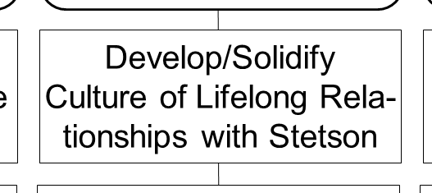
Develop Culture of Lifelong Relationships (D-1)
“How can we solidify the students’ lifelong relationships with Stetson, and use this relationship to amplify the significance in Stetson’s role in student accomplishments, and vice-versa.”
- Dr. Beth Paul
Portfolios by definition are lifelong, showcase academic and professional accomplishments
These relationships can be used by HART volunteers and the Alumni Association to strengthen the bonds between alumni and Stetson

Slide 13
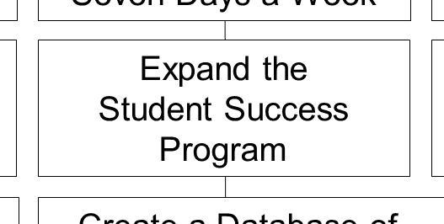
Expand Student Success Program (D-3)
“Lots of energy in improving, expanding, interconnecting efforts to support the success and significance of our students”
- Dr. Beth Paul
Co-curricular learning’s impact is traditionally difficult to assess; a great strength of portfolios come from the ability to directly reflect upon participation in co-curricular activities; these reflections could be used to assess the impact of such learning, a more accurate measure of significant impact

Slide 14
Create a Database of Student Experiences (DE-4)
“We need to get the different data related, to help students to recognize and track their academic and professional progression from pre-admission achievement, to student accomplishments, to post-graduate success”
- Dr. Beth Paul
Integration of a portfolio system with Banner is possible, to add to Banner, or to mine data from Banner to populate the portfolio system, including fostering legacy alumni involvement

Slide 15
Create a Database of Student Experiences (DE-4)
“Stetson can use this data to make choices on how to move Stetson forward.”
- Dr. Beth Paul
Portfolios provide data to help design policies, in conjunction with the IRO and university governing bodies

Slide 16
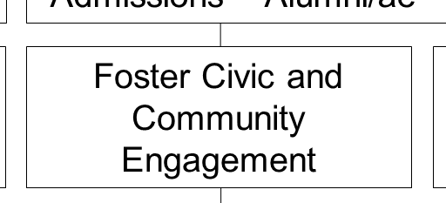
Foster Civic and Community Engagement (D-5)
“We have a great tradition of making a difference, we must celebrate and promote our great tradition of community engagement and engaged learning.”
- Dr. Beth Paul
Portfolios provide evidence of these efforts, and showcase community engagement from the individual student’s perspective, reinforcing the motivation to continue these efforts

Slide 17
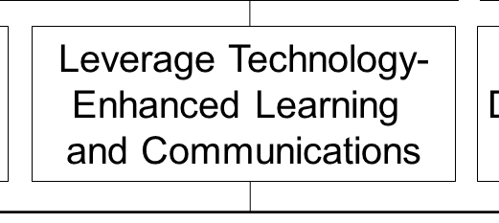
Leverage Technology – Enhanced Learning (E-5)
“The 21st century learner’s technology is evolving fast, we have different tools and technology to learn from; we need to stay on the cutting edge, to make sure we use these tools in the best way to advance our mission”
- Dr. Beth Paul
Portfolios facilitate 21st century learners’ predilection toward technology and communications
The establishment and maintenance of a professional portfolio will help prepare students for a life beyond Stetson, in further academic careers or professional careers

