Slide 1
A Modular Approach to Designing ePortfolio Systems for College Freshmen
A flexible approach to starting small
Presentation by Eric Hoffman, 5 November, 2013
Notes:
Hi, as we begin, I’d like to ask, according to popular culture 50 years ago, what are little boys made of?
What are little girls made of?
That sort of sexist talk used to get me quite angry when I was a kid, but now I know it was ignorance of anatomy.
This presentation is designed to help you easily understand and explain what ePortfolios are made of, and how the anatomy all fits together.
This presentation starts out like ePortfolios 101, but I also address how it is designed at Stetson University to address the needs of freshmen. And provide the theoretical framework for the model.
My name is Eric, and we’re going to look at a flexible approach to starting small.

Slide 2
Why Flexible and Small?
Trent Batson (2011):
The Social Web and services will quickly become part of the educational process
Campus life will become only richer (co-curricular activities)
Portfolio standards will not be universally recognized for years
Rapid changes in technology (especially mobile) are occurring faster than institutional capability to adapt
Small pilot implementations are lower risk, although they require longer-term visibility among administrators

Slide 3
Agenda
Audience assessment
ePortfolio components and structure
The enzyme analogy
Types of ePortfolios
Implementation at Stetson University
The modular model
The stakeholders and supporting framework
Notes:
I will present this information, and conclude with a demonstration of redacted ePortfolios from students who granted me written permission to demonstrate their ePortfolios. I remember how frustrated I was, to not be able to see representative ePortfolios, when I first started out.

Slide 4
Audience Assessment
Who Are You? Show of hands, if you feel comfortable.
New to ePortfolio implementation?
Teacher or SME tasked with starting an ePortfolio implementation, in/voluntarily?
Considering altering your current implementation?
Administrator or other interested in the modular model?
Comfortable in your current location?
Notes:
Why are you here?

Slide 5
Types of ePortfolios?
Showcase – Audience?
Career/Employment – Audience?
Assessment – Audience?
Development – Audience?
Research – Audience?
You should be able to have more than one type of ePortfolio, accessing some of the same content: “Type of ePortfolio”=“Collection”
Notes:
Let’s get interactive here. Let’s take a look at some of the types of ePortfolios. And very importantly, determine the specific audience, or target market for each type.
Are there others? Who’s the audience?
The most important point of thi slide, is that for any given type of ePortfolio, there’s a different audience.
In the Mahara ePortfolio system in use at Stetson, these multiple ePortfolios are called collections

Slide 6
Introduction to ePortfolio Components
From smallest to largest:
Artifact: a text box, image, blog entry, link to a file, link to a video, or any other chunk of content
Page: a Web page that contains an organized group of artifacts
Collection: an organized linked group of pages, linked to each other by a consistent menu
Notes:
I presume the audience for this session is mostly composed of people relatively new to ePortfolios. If you already know this stuff, please bear with me.

Slide 7
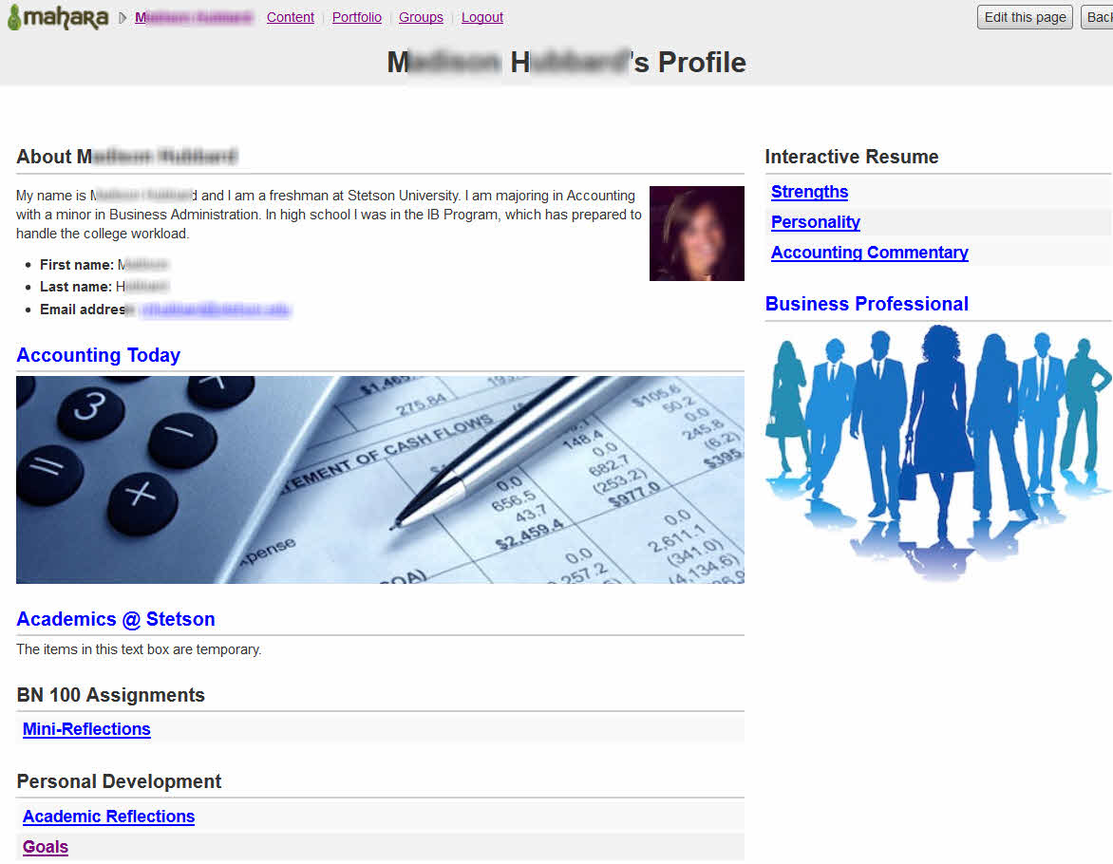
Example ePortfolio
Notes:
This example shows the “profile” page of a student using the Mahara open source ePortfolio system, in use at the Stetson University School of Business Administration.
Your system is probably different to some extent, but the results should be generalizablle.

Slide 8
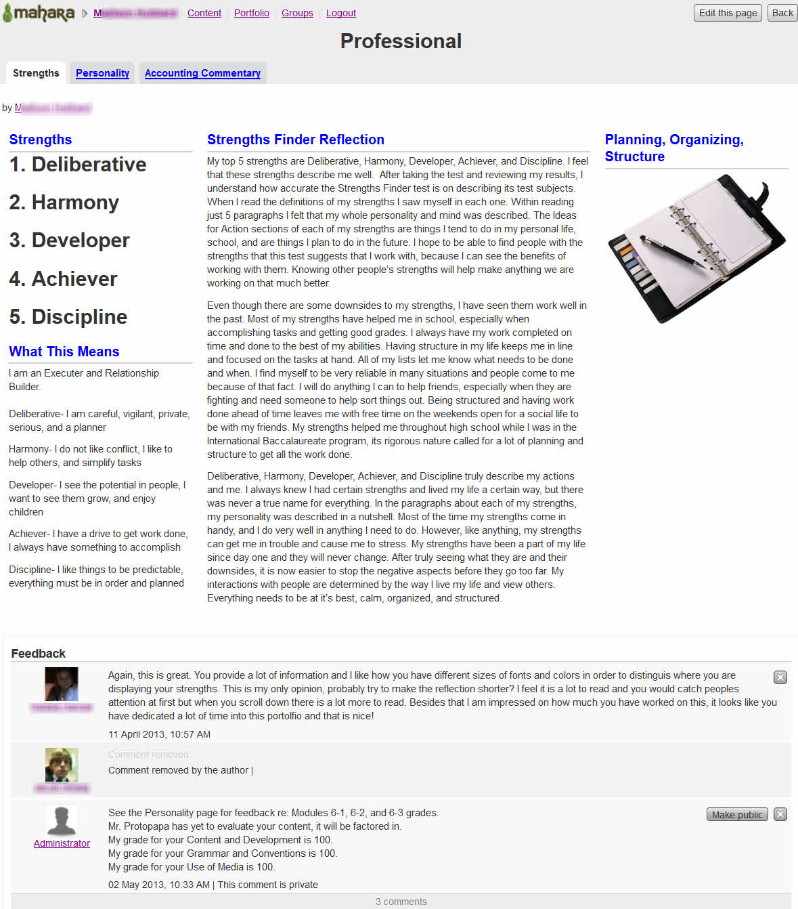
Artifacts
Notes:
At the most granular level, artifacts are the small chunks that make up the content of ePortfolios

Slide 9
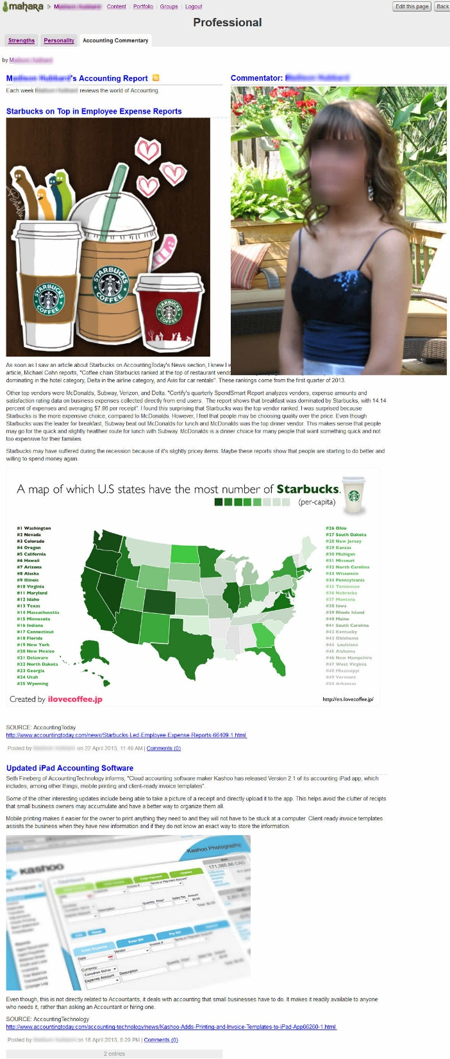
Page
Notes:
All artifacts reside on a page – in the form of a Web page, in fact. What makes them different is the context. The main difference is that the eP page fits within a formal system ef an eP.

Slide 10
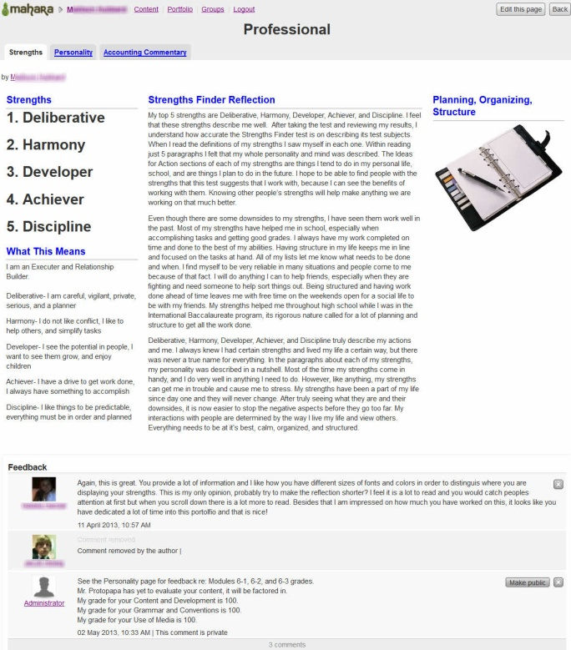
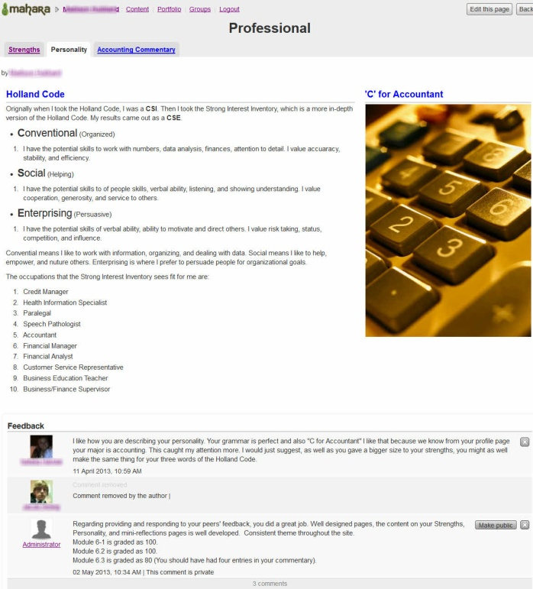
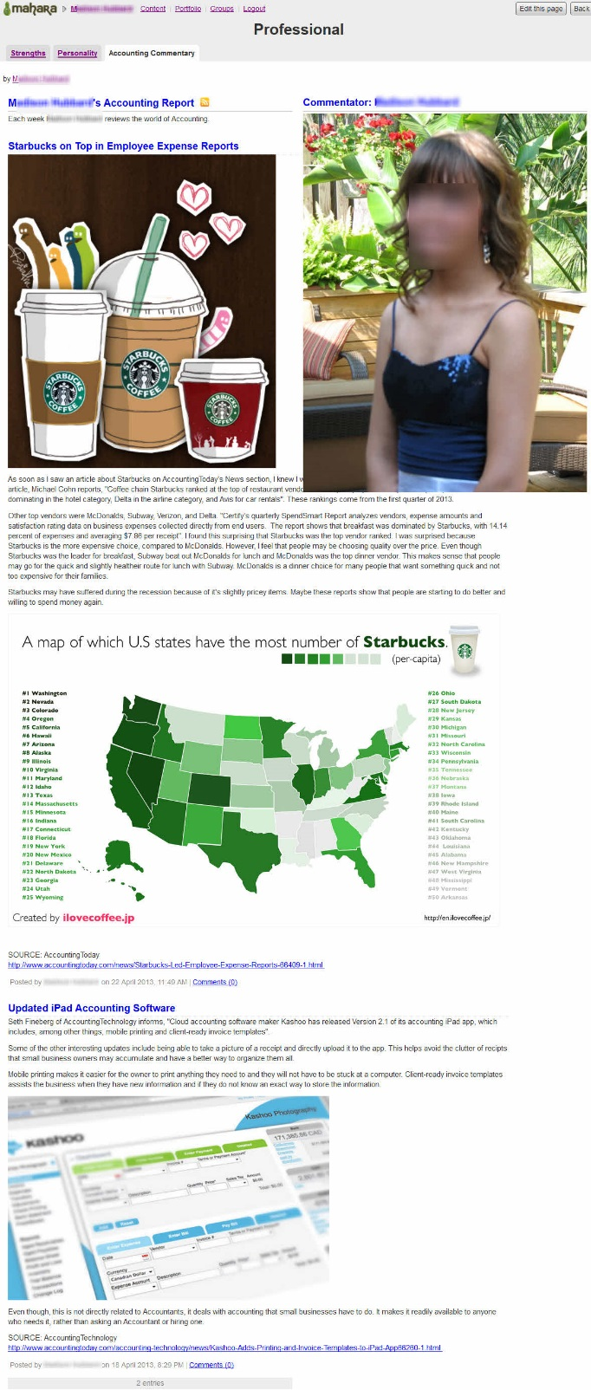
Collection
menu
Notes:
A collection is a group of pages that are held together by a common purpose, and a common menu.

Slide 11
Structure
Collection
Page 1
Artifact 1
Artifact 2
Page 2
Artifact 4
Artifact 3
Artifact 5
Page 3
Artifact 6
Artifact 7
Notes:
This slide shows the hierarchy of a hypothetical collection. Students will have multiple collections, to meet the needs of their audiences.

Slide 12
Collection
Collection 1
Page 1
Artifact 1
Artifact 2
Page 2
Artifact 4
Artifact 3
Artifact 5
Page 3
Artifact 6
Collection 2
Page 4
Artifact 2
Artifact 5
Page 5
Artifact 7
Artifact 8
Artifact 9
Artifact 7
Notes:
Reiterate the concept:
A collection is a series of ePortfolio pages, held together by a common menu, designed for a specific audience.
So when people talk about different types of E portfolios, they might be talking about different types of collections, designed for different audiences.
And each collection should be able to access artifacts from the same pool of artifacts.
So the ePortfoiio system could contain multiple Collections, each containing multiple pages, each containing multiple artifacts, some of which might be duplicated across different collections. For example, Artifact 2 can appear in Collections 1 and 2, just like artifacts 5 and 7.

Slide 13
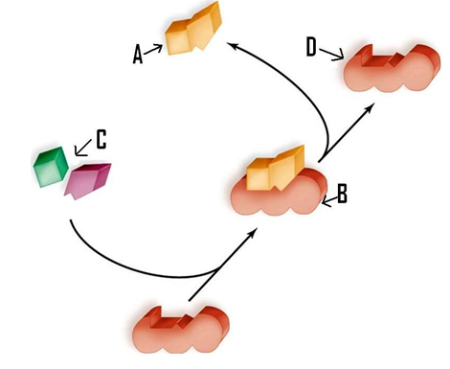
The Enzyme as an ePortfolio Analog
“Digestable” polished ePortfolio collection
eP in development
“Undigestable” artifacts (disparate content)
ePortfolio infrastructure
“Enzymes” - Some rights reserved by SweetChickaD, flickr.com
Notes:
The desired end result is a polished eP collection (A), but it needs to be developed in the context of the eP (B). The rough artifacts (C) are required to fit the constraints of the requirements of the ePortfolio infrastructure (D).
When designed in this way, the artifacts fit with each other I a polished, cohesive whole collection, fitting within the framework of the infrastructure. One thing I like about the enzyme analogy, is that the artifacts just need to fit the eP infrastucture on one side, they can otherwise be as individualized as needed. And just like real enzymes, as far as I know, the artifacts generally are multi-faceted.

Slide 14
Mahara Implementation at Stetson
School of Business
Pilot phase
Currently in third year
Expanding to multiple courses and professors
General lack of administrative support
Plan to implement Tenure & Promotion collections as the carrot to entice faculty to learn to use the system
Notes:
This program focuses on incoming freshmen, as they are the most vulnerable to attrition – Should increase social and academic integration, increase retention

Slide 15
Mahara Implementation at Stetson
Instructions for entry level class available to all
Rubric, examples, and videos provide self-paced scaffolding materials to support the syllabus and asignments
Relies on group activities for peer feedback and first-level support
An experienced student assistant is the second line of support
http://mahara.stetson.edu
Notes:
The rubric is based on the AC&U’s VALUE rubrics

Slide 16
The Modular Model at Stetson: Collections
Students have ePortfolios organized into multiple COLLECTIONS:
Professional (career)
Personal Development
Developmental (class)
Each COLLECTION can be viewed by corresponding audience:
General public
Advisors
Instructor (and instruction team), classmates
Notes:
The Professional collection is designed to serve as the student’s showcase to the world, evidence of high-level accomplishments.
The Personal Development collection is used by the student and advisors throughout the academic career, to confirm progress toward the educational goals, and address any problems within a closed, trusted environment. Permissions to view are controlled by the student.
Each class will have its own collection, and be viewable by the instructor and his/her support team), as well as classmates. Major co-curricular activities or organizations will be similarly structured.

Slide 17
The Modular Model at Stetson Concept: Duration
Professional: Permanent
Personal Development: Duration of enrollment
Individual Class: Semester-long, then archived
Co-Curricular Organization: Duration of enrollment
Notes:
Any given collection can be considered “permanent,” but will generally only be active and growing, as long as it makes sense. For example, when a class is finished, students won’t be contributing to it. However, they will be contributing to their professional portfolios, throughout their academic careers, and possibly well into their professional careers. The Alumni and Development offices like this, as it creates ties with the school after they graduate, at the cost of a little cheap storage, and a miniscule amount of bandwidth.

Slide 18
The Modular Model: Example Assessment
Professional: Office of Career Development manual assessment
Personal Development: Advisor manual assessment each semester
Individual Class: Instructor and peer assessment according to rubrics – database “hooks” correspond with competencies and/or curriculum mapping
Co-Curricular Organization: Advisor manual assessment each semester, or at conclusion of events
Research: Annual competition by a panel of judges
Notes:
This illustrates the people in a given institution who might assess the given collections. Some assessments might be more formal than others, and each assessment must match the institution’s strategy.

Slide 19
The Modular Model Concept: Example
Student:
Jean Aucoin
(automatic eP)
Class:
ART112
No eP
Class:
ENG 101
eP active
Class:
BN 100
eP active
Class:
PSY201
No eP
Co-Curr:
Art Atalier
eP active
Professional
Personal Development
ENG 101
BN 100
Art Atalier
Collections
Notes:
Not all classes will use ePortfolios. In fact, most will not, at least not in the beginning. Co-curricular entities are a great potential users of ePortfolios, and should be considered as part of the assessment process.

Slide 20
The Modular Model Concept: Copy Artifacts Into Collections
Still life painting
Internship plan
Art Atalier
Professional
Personal Development
Animation
Biography
Essay on Marketing
ENG 101
BN 100
Collections
Notes:
Students may be directed, requested, or volunteer to copy the best of their work into theoir professional collection. Ultimately, the eP belongs to them.

Slide 21
Genesis of the Modular Model
Retrieved from http://arcmit01.uncw.edu/erg1602/Glossary.html
Notes:
In the great tradition of my favorite instructional and theoretical models, cyclical information flows in a clockwise fashion. Here is the Morrison, Ross, and Kemp model of instructional Design.

Slide 22
Genesis of the Modular Model
Retrieved from http://www.nwlink.com/hrd/styles/kolb.html
Notes:
Important to the concept of co-curricular learning, and enabled by ePortfolios, Kolb’s Experiential Learning model is presented here.

Slide 23
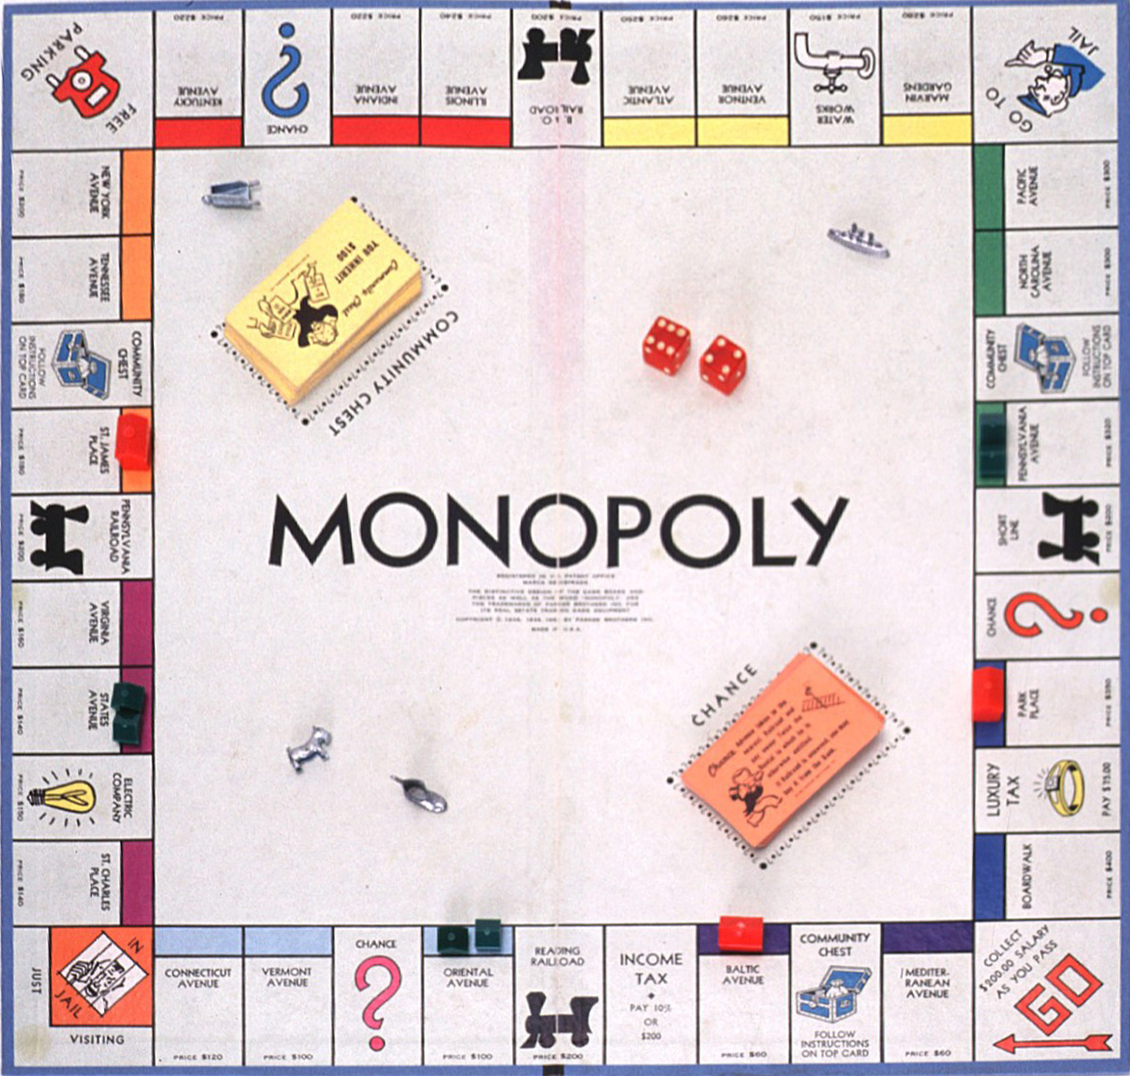
Genesis of the Modular Model
Retrieved from http://midastouch.goldgenie.com/tag/gold-monopoly-set/
Notes:
And perhaps the most applicable circular model, to ePortfolios, is the game of Monopoly.

Slide 24
Modular Model Student-Centric Core
I.I.
serious interaction
I.I.
STUDENT
fun interaction
polish & assess
I.I.
mechanics
I.I.
I.I.=Instructor Intervention
Notes:
While it might seem a bit trite, it is an easily understandable framework, using a mnemonic familiar to most stakeholders. Each side of the board represents a form of learner interaction. Each corner represents instructor interaction.

Slide 25
Modular Model Student-Centric Core Details
I.I.
ac ac ac ac ac ac
I.I.
STUDENT
Challenging group construction, serious interaction, peer assessment and feedback
Assignments & community building - fun interaction
Polish, copy to professional collection, final assessment & archive
ac ac ac ac ac ac
ac ac ac ac ac ac
ac = student activities
Mechanics - the computer science of eP
I.I.
I.I.
ac ac ac ac ac ac
Notes:
To incorporate ePortfolios within a class, this diagram illustrates the student centered activities at each stage.
These activities should be designed to help the learner accomplish the goals of each stage
On the bottom side, learners are presented with scaffolding activities, to learn or reinforce the computer science associated with electronic portfolios.
On the left side, learners are presented with a number of community building or fun activities, to reinforce the use of ePortfolios.
On the top side, more challenging construction is assigned, and you are assessment and feedback helps learners refine concepts, with in the framework of the learning community.
On the right side, learners will polish their work, copy the best of their work to their professional or other collections, and otherwise prepare the collection for final assessment.

Slide 26
Modular Model Instructor Intervention Details
Assess group progress & cohesion, intervene as needed
I.I.
I.I.
Assess group activities, reinforce results
STUDENT
Assess final eP, results to institution, create next course or entity
Assess construction, intervene as needed
I.I.
I.I.
Notes:
At the start, the instructor implements the electronic portfolio as part of the course design.
Activities should be built into the schedule and syllabus, and be included in the assessment process.
In the lower left corner, the instructor should quickly evaluate whether the basic structure is in place for the course, providing basic feedback and recommending intervention as needed.
In the upper left corner, the instructor should assess the progress of the group including cohesion and interaction, possibly intervening.
In the upper right corner, the instructor assesses group activity, including interactivity, and reinforce positive results.
Finally, in the lower right corner, the instructor assesses the final results, and provides these to the institution.
And the cycle starts again for the next class.

Slide 27
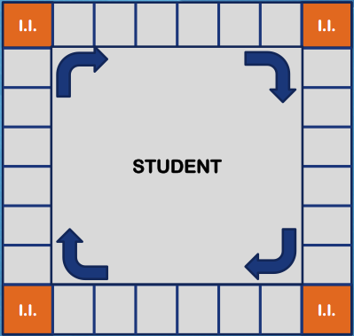
The Larger Framework of the Modular Model
Societal, customer, and institutional foci
I.R.O.
Accreditation, etc.
Marketing
Showcasing, etc.
results
???
Other uses
Notes:
The results of the student electronic portfolios would be delivered to the institution for accreditation, showcasing, and other uses.
One example, might be the use of the office of alumni relations, to keep students involved in the institution, after they graduate.
Portfolio collections can also be publicly available to meet the needs of granting agencies or other secondary institutional customers

Slide 28
ePortfolios – Who cares?
Stakeholders:
Society – “the public,” governments, agencies, foundations
Customers – students, hiring businesses
Institution – faculty, staff, administration
Notes:
Helen Chen and Tracy Penny-Light state that identification of stakeholders, and identifying their needs can help win support for ePortfolios (Chen & Penny-Light, 2010, p. 10).
Knight, Hakel, and Gromko (2008) provide a lot of evidence that “Members of the public, employers, and legislators are concerned with the perceived lack of attention that faculty give to undergraduate learning” (p. 1).
The Hart Research Group (2013) reported that 80% of employers believe they would benefit from examining the ePortfolios of job candidates, but students generally are not aware of the importance of ePortfolios
Institutional support of ePortfolios is difficult to implement. For example, after Gail Ring was charged with the implementation of institution-wide ePortfolios at Clemson, she noted that key faculty and staff were disinterested, despite the institutional mandate (Schaffhauser, 2010, p. 33). This has changed due to persistence and a solid plan, but points to general resistance to change.

Slide 29
Alignment of Stakeholders and Orientation
Stakeholders
Society – “the public,” governments, agencies, foundations (mega)
Customers – students, hiring businesses (macro)
Institution – faculty, staff, administration (micro)
Orientation (ePortfolio types):
Assessment – accreditation, evidence of (program) success and worthiness
Career/Showcase – evidence beyond diplomas/transcripts
Learning Development – evidence of engagement, experiential learning
Notes:
Using Roger Kaufman’s (2001) Organizational Elements Model, we can try to align the stakeholders with they typical orientation of ePortfolios. Unless an institution understands the potential of all types of ePortfolios, and fully supports them down to the faculty/staff level, and incorporates them into its culture, success is likely to be haphazard.

Slide 30
Ideal Alignments and Prioritization
Student learning
Faculty and staff
Programmatic connections
Institutional needs & support
Stakeholders - Orientation
Society – Assessment
Customers – Career/Showcase
Institution – Learning Development
Adapted from Bass, 2012
Notes:
The ongoing “Making Connections” project led by Brett Eynon (Bass, 2011; Making Connections, 2013) prioritized the elements of successful ePortfolio implementation, with student learning as the greatest priority.
Notice that the pyramid, is contained in the lowest level of the Stakeholder/Orientation list.
This should not be a problem, as long as the institution’s mission and activities support the concept that student learning is the highest priority.

Slide 31
Societal Needs and Assessment
Assessment ePortfolio as a management-oriented accountability measure – checking of results - versus use as a tool for attainment of learning
Assessment lite: reduces initiative and creativity
Possible motivations for assessment (Ewell):
Benchmark institutional performance in the name of accountability as in K-12 education
Provide feedback about student performance to improve curricula and pedagogy
Determine an individual student’s mastery of learning and to provide feedback for improvement
Notes:
Societal concern about the quality of higher education probably precipitates assessment-driven ePortfolios, as a quantifiable accountability tool.
Chinese-born Education Researcher Yong Zhao asserts that in its quest for universal accountability, the U.S. education system is transforming itself from a producer of independent thinkers and entrepreneurs into a system that produces skilled vocational workers competing with outsourced cheap labor from around the world (Pierce, 2013).
Ewell (2002) states that current assessment efforts generally have a wide but shallow scope, resulting in a waste of energy and effort. He questions the current popular motivations for institutional assessment, stating that such efforts ultimately have little positive impact on education.
The first motivation here is relatively easy for institutions, but really have little societal impact. The second and third motivations are more expensive, but result in high-impact practices, that positively affect society, customers, the institution, and its constituent members.

Slide 32
Customer Needs: Students, and Hiring Businesses
Why Johnny Can’t Read; basic number skills test; years of experience; subjective judgment based on “personality” (Flesch, 1956)
Innovation, critical thinking, and a broad skill set are important for taking on complex challenges in the workplace (Hart Research Group, 2013)
Students: disconnect between ePortfolio benefits and results: how is this relevant?
Notes:
The AAC&U sponsored a study (Hart Research Associates, 2013), that showed strong employer interest in much higher skills that 57 years ago, including direct recognition for ePortfolios, and how they can provide evidence of these desired traits, well beyond the traditional diploma and transcript.
Although I formally haven’t researched it, my experience shows that college freshmen need a lot of reinforcement to keep up their ePortfolios. There are lots of distractions on campus.

Slide 33
Institutional Needs: Faculty, Staff, Administration
Except for early adopters, most institutional stakeholders don’t understand ePortfolios and the steps required
Incorporating co-curricular (high-impact) practices are more powerful, and easily afforded by ePortfolios; yet they are highly disruptive to traditional university hierarchies, and are potentially expensive
Notes:
Helen Chen and Tracy Penny-Light (2010) wrote a and excellent 44 page booklet on implementing ePortfolios. But getting buy-in from all the stakeholders is difficult, as understanding the implications requires a significant expenditure of the precious commodities of time and effort, just to give the concept due diligence. This might be the major initial obstacle for proper consideration of an institution-wide implementation of ePortfolios. This is also the reason why an early adopter approach might be best for an institution.
Randy Bass (2012) suggests using a designed team-based approach to teaching with technologies, especially ePortfolios. This would include instructional designers, information technologists, embedded librarians, academic advisors, all coordinated by the faculty member. Although this approach can be expensive, economies of scale and utilization of existing resources can create more a more effective learning experience with a somewhat modest cost increase.

Slide 34
References:
Bass, R. (2012). Disrupting Ourselves: Cherished Assumptions, New Designs, and the Problem of Learning in Higher Ed. Paper presented at the Mid-Atlantic Regional Conference, Baltimore Maryland http://www.educause.edu/MARC12/Program/GS01.
Batson, T. (2011). A Portrait of the Portfolio as a Young Movement: A Surprising Development Paper presented at the Campus Technology Virtual Conference, Virtual.
Chen, H., & Light, T. P. (2010). Electronic portfolios and student success: Effectiveness, efficiency, and learning. Washington, DC: Association of American Colleges and Universities.
Ewell, P. T. (2002). An emerging scholarship: A brief history of assessment. In T. W. Banta & Associates (Eds.), Building a scholarship of assessment (pp. 3–25). San Francisco: Jossey-Bass.
Flesch, R. (1955). Why Johnny can't read--and what you can do about it. New York, Harper [1955].
Hart Research Associates (2013). It takes more than a major: employer priorities for college learning and student success. Washington, DC: Association of American Colleges and Universities and Hart Research Associates.
Kaufman, R., Watkins, R., & Leigh, D. (2001). Useful educational results. Lancaster, PA: Proactive Publishing.
Knight, W. E., Hakel, M. D., & Gromko, M. (2006). The relationship between electronic portfolio participation and student success. Association for Institutional Research, Chicago, IL.
Kolb, D. A. (1984). Experiential learning: Experience as the source of learning and development (Vol. 1). Englewood Cliffs, NJ: Prentice-Hall.
Making Connections (2013). Making Connections (Web site). Retrieved July 15, 2013 from http://www.lagcc.cuny.edu/connections/.
Malm, F. (1955). Hiring procedures and selection standards in the San Francisco bay area. Industrial & Labor Relations Review, 8(2), 231.
Morgan, W. J., & Morgan, A. (1952). Basic Number Skills Test for Employee Selection.
Morrison, G. R., Ross, S. M., Kemp, J. E., & Kalman, H. (2010). Designing effective instruction. Wiley. com.
Pierce, D. (2013). Zhao: U.S. schools focusing on the wrong skills (Web site). Retrieved from http://www.eschoolnews.com/2013/07/24/zhao-u-s-schools-focusing-on-the-wrong-skills/

Slide 35
About the Presenter
Eric W. Hoffman, Ed.D. expected August 2014
Academic foci: ePortolios, mobile game-based learning
Formerly Associate Director of Media Services at Stetson University, currently consultant
http://about.me/erichoffman DOWNLOAD the presentation

